Slide 1
Speech Synthesis Using Deep Learning
Siddhant Bikram Shah 2K19/CO/374
Sonu Kumar Kushwaha 2K19/CO/383
Ayush Karn 2K19/CO/454

Slide 2
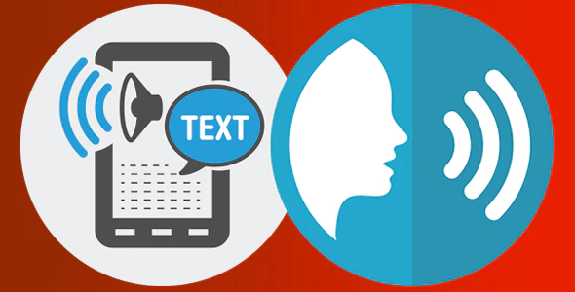
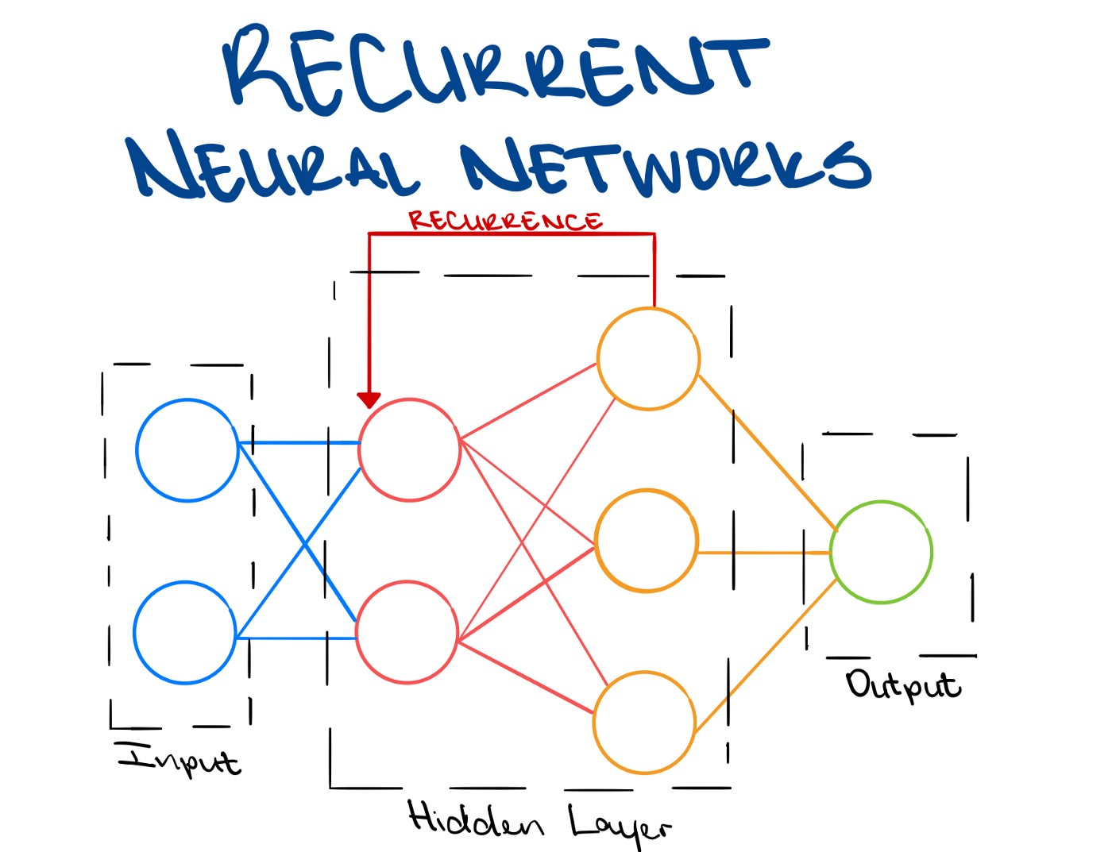
Topics
Abstract
Introduction
Research Methods
Analysis
Implementation
Result and Discussion
Applications
Conclusion and Future Research Directions
References

Slide 3
Abstract
The artificial production of human speech is known as speech synthesis. This machine learning-based technique is applicable in text-to-speech, music generation, speech generation, speech-enabled devices, navigation systems, and accessibility for visually-impaired people.
Deep Learning is a subset of machine learning that consists of algorithms inspired by the structure and function of the human brain called neural networks. Deep Learning has been said to make revolutionary advances in the machine learning and artificial intelligence field.
In this project, we aim to build a speech synthesizer using Deep Neural Networks. The program would extract some characteristics from a few samples of the speaker's voice, clone it and generate audio based on the given text. The performance of the program is determined by the naturalness of speech and the similarity between the speaker’s speech and the recreated speech.

Slide 4
2. Introduction
Deep learning is very popular in many sub-disciplines of machine learning. It is predominant in text-to-speech, which is the assistive technology that converts text to spoken word. A lot of research has been done to make these deep learning models more efficient and generate more natural-sounding speech. Some models even produce artificial speech that is almost indiscernible from human speech.
This study aims to work towards and implement an efficient and potent voice cloning model. It should be able to clone voices with only a few seconds of reference input audio. I will apply the work of (J. Corentin et al, 2018) along with my own implementation and dataset.

Slide 5
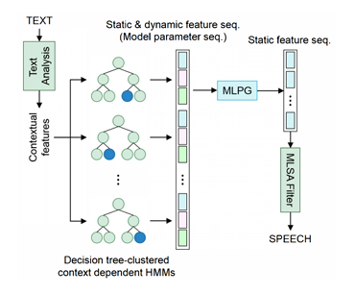
3. Research Methods
Hidden Markov Model (HMM) based framework approach consists of clustering the linguistic features extracted from the input text with a decision tree, and training an HMM per cluster. The HMMs are tasked to produce a distribution over spectrogram coefficients, their derivative, second derivative, and a binary flag that indicates which parts of the generated audio should contain voice.
WaveNet(2016) is a deep convolutional neural network that, for a raw audio waveform, models the distribution of a single sample conditionally to previous ones made a substantial breakthrough in TTS(text-to-speech). It is thus possible to directly generate audio by predicting samples one at a time in an autoregressive fashion. WaveNet leverages stacks of one-dimensional dilated convolutions with a dilation factor increasing exponentially with the layer depth, allowing for the very large receptive field and the strong nonlinearity needed to model raw audio.

Slide 6
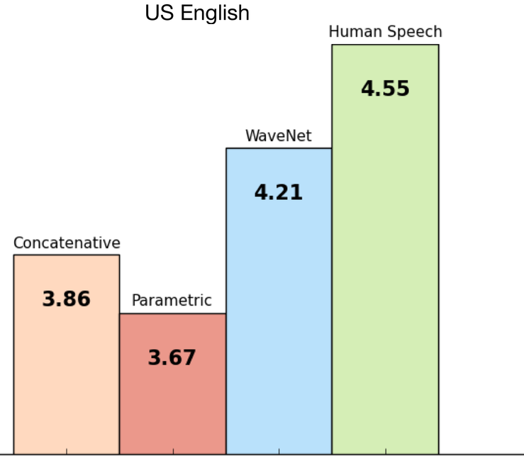
3. Research Methods
Improvements to this framework were later brought by feed-forward Deep Neural Networks (DNN-2013) which has better data efficiency as the training set is no longer fragmented in different clusters of contexts.
RNNs(2014) make natural acoustic models as they are able to learn a compact representation of complex and long-span functions. As RNNs (Recurrent Neural Network) are fit to generate temporally consistent series, the static features can directly be determined by the acoustic model, alleviating the need for dynamic features and MLPG (Maximum Likelihood Parameter Generation algorithm)
WaveNet(2016)- is a deep convolutional neural network that, for a raw audio waveform, models the distribution of a single sample conditionally to previous ones made a substantial breakthrough in TTS. It is thus possible to directly generate audio by predicting samples one at a time in an autoregressive fashion.
Tacotron(2017) a sequence-to-sequence model that produces a spectrogram from a sequence of characters alone, further reducing the need for domain expertise.

Slide 7
4. Analysis
The three stages of the framework are as follows:
A speaker encoder that derives an embedding from the short utterance of a single speaker. The embedding is a meaningful representation of the voice of the speaker, such that similar voices are close in latent space. Silent audio longer than 0.2s is trimmed.
A synthesizer that, conditioned on the embedding of a speaker, generates a spectrogram from text. This model is the popular Tacotron 2 real-time without WaveNet.
A vocoder that infers an audio waveform from the spectrograms generated by the synthesizer. We used WaveNet as a vocoder, effectively reapplying the entire Tacotron 2 framework.

Slide 8
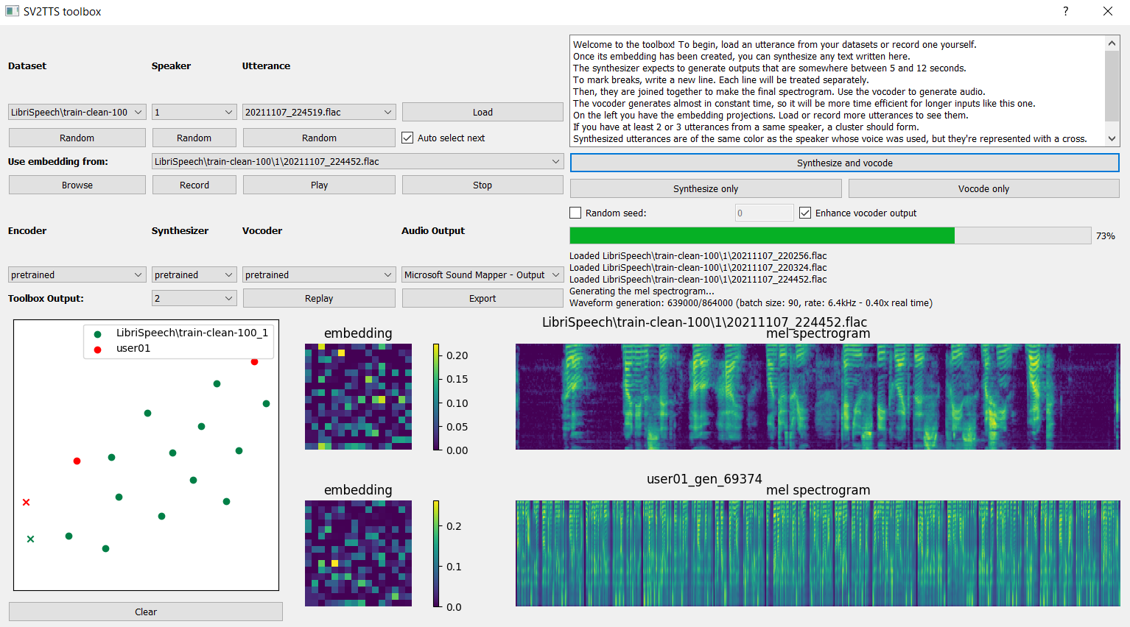
5. Implementation

Slide 9
6. Result and Discussion
In this implementation, the voice recognition section works almost flawlessly whereas the speech synthesis works adequately well. Speech similarity is quite high, whereas speech naturalness can be improved. Overall, the results were very satisfactory and above our expectations.
Since this framework was run on a computer with a relatively weak GPU along with time and computational constraints, it is possible that the results did not achieve their full potential. The model was trained for a million steps, whereas the original author trained it for 50 million steps and achieved slightly better results. With an even more powerful computer, the results would likely have been even closer to human levels by achieving even greater naturalness and similarity.

Slide 10
7. Applications
The most important application of speech synthesis is the reading and communication aids for the blind.
It can be programmed for special tasks like spelling and pronunciation teaching for different languages and can also be used with interactive educational applications.
An automatic speech recognition system is used in development of interactive multimedia applications, facilitating voice interaction.
In the future, if speech recognition techniques reach adequate level, synthesized speech may also be used in language interpreters or several other communication systems, such as talking mobile phones.

Slide 11
8. Conclusion and Future Research Directions
A framework for real-time voice cloning was studied and implemented. The results exceeded expectations but could be improved with more reference speech time.
Proper datasets for audio-based projects such as this are relatively insufficient. The SV2TTS team has been working on a vocoder that could clone most voices, but not uncommon ones. In the future, new frameworks could be developed that account for this overlooked aspect as well.
The importance of research in text-to-speech increases day by day since many leading technology companies aim to adopt their own artificially intelligent chatbot or personal assistants. Developments in this field are being made all the time and we would like to study and implement them in the future.

Slide 12
9. References
Corentin Jemine. Real-time Voice Cloning, 2018 https://matheo.uliege.be/bitstream/2268.2/6801/5/s123578Jemine2019.pdf
Dzmitry Bahdanau, Kyunghyun Cho, and Yoshua Bengio. Neural machine translation
by jointly learning to align and translate. CoRR, abs/1409.0473, 2014. http://arxiv.org/abs/1409.0473.
Jan Chorowski, Dzmitry Bahdanau, Dmitriy Serdyuk, KyungHyun Cho, and Yoshua
Bengio. Attention-based models for speech recognition. CoRR, abs/1506.07503,
2015. http://arxiv.org/abs/1506.07503.

